Slide 1
How Does the
Web Work?
01
I399 Web Development

Slide 2
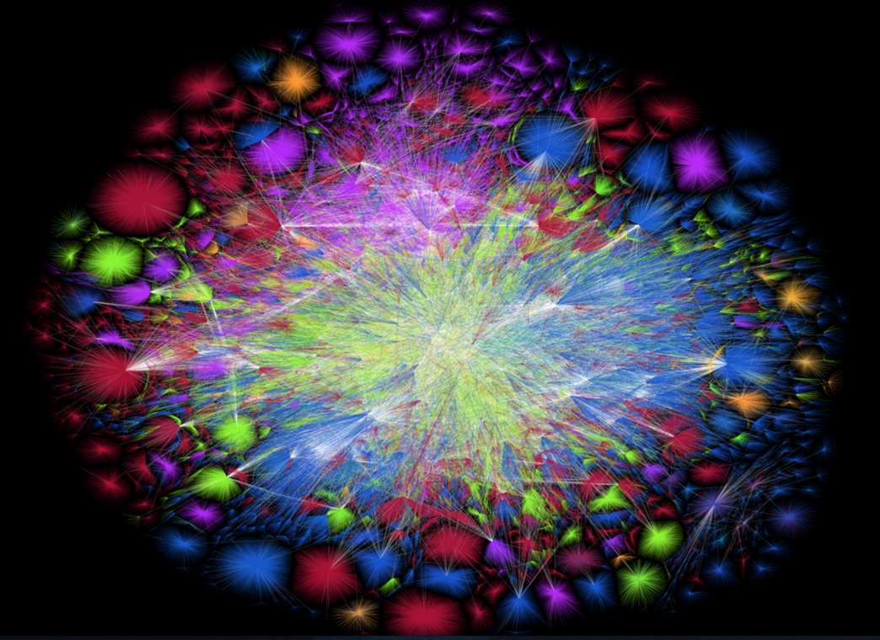
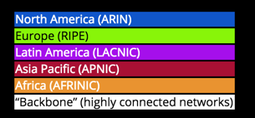
Notes:
4.72 billion indexed pages
opte.org
This is from 2015.
“from every single one of these pages you can navigate to any other in 19 clicks or less.”
http://mashable.com/2013/02/18/19-clicks-internet/
http://www.worldwidewebsize.com/

Slide 3
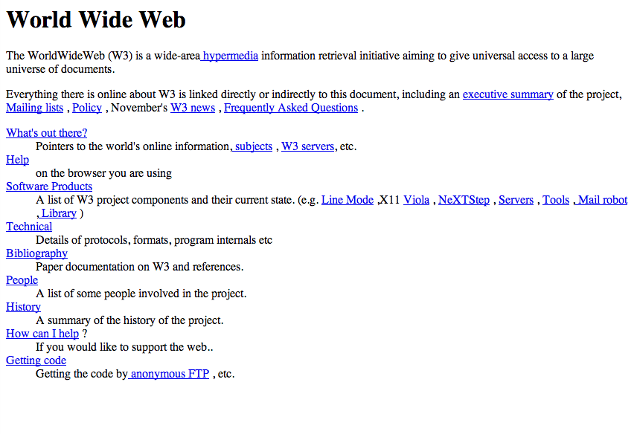
6 August 1991, CERN
Notes:
http://info.cern.ch/hypertext/WWW/TheProject.html
http://arstechnica.com/information-technology/2013/04/first-website-ever-goes-back-online-on-the-open-webs-20th-birthday/
The web has also changed quickly.. From the first website to what we have now.

Slide 4
What is the difference between
the internet and the web?

Slide 5
1969

Slide 6
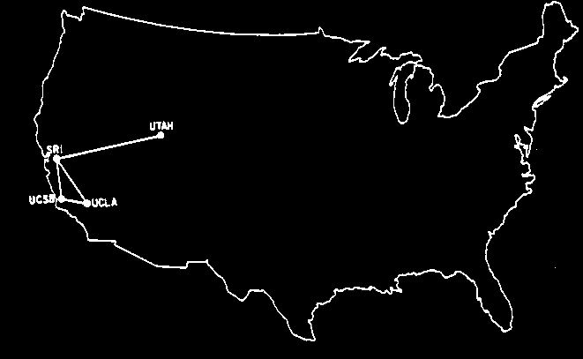
Web interconnectivity in 1969.
Notes:
Internet was originally for researchers to share data and information.

Slide 7
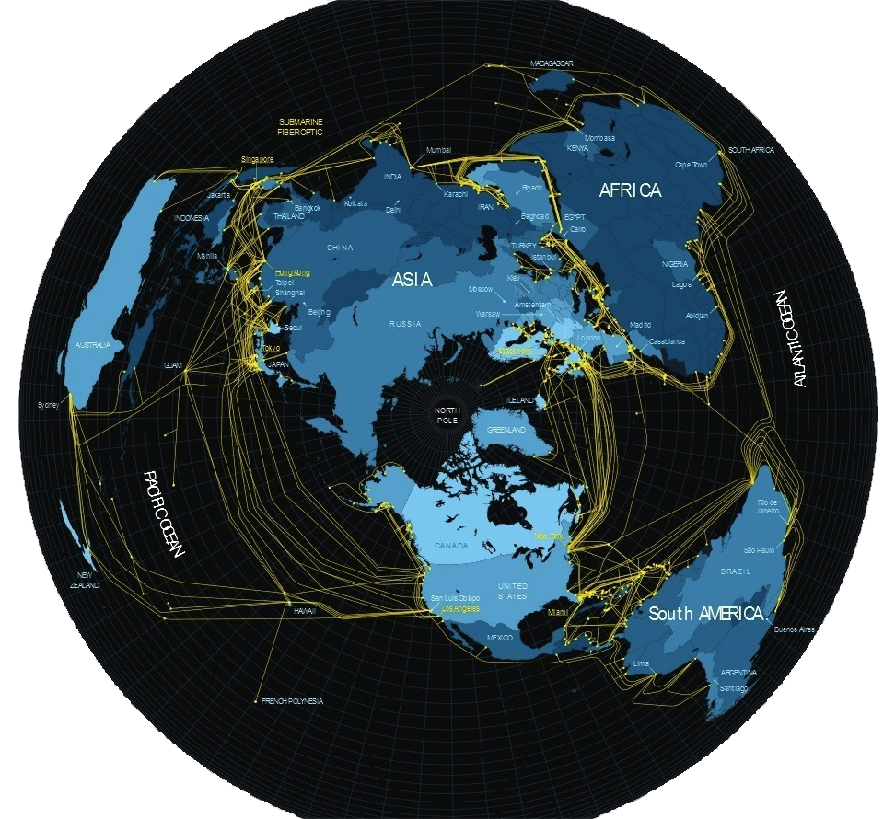
Undersea internet cables (2013).
Notes:
submarinecablemap.com / Via healthintelligence.drupalgardens.com

Slide 8
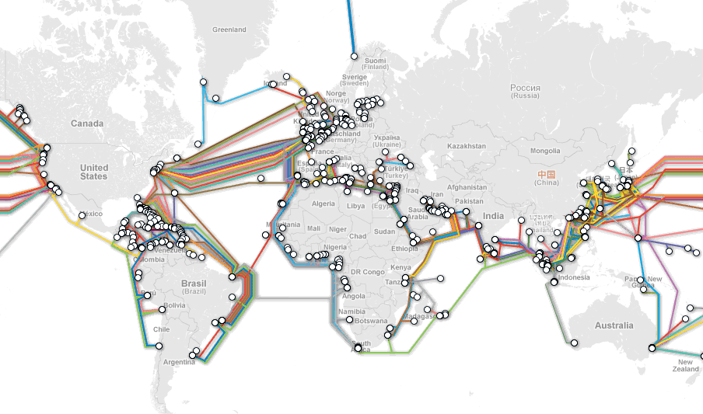

Slide 9
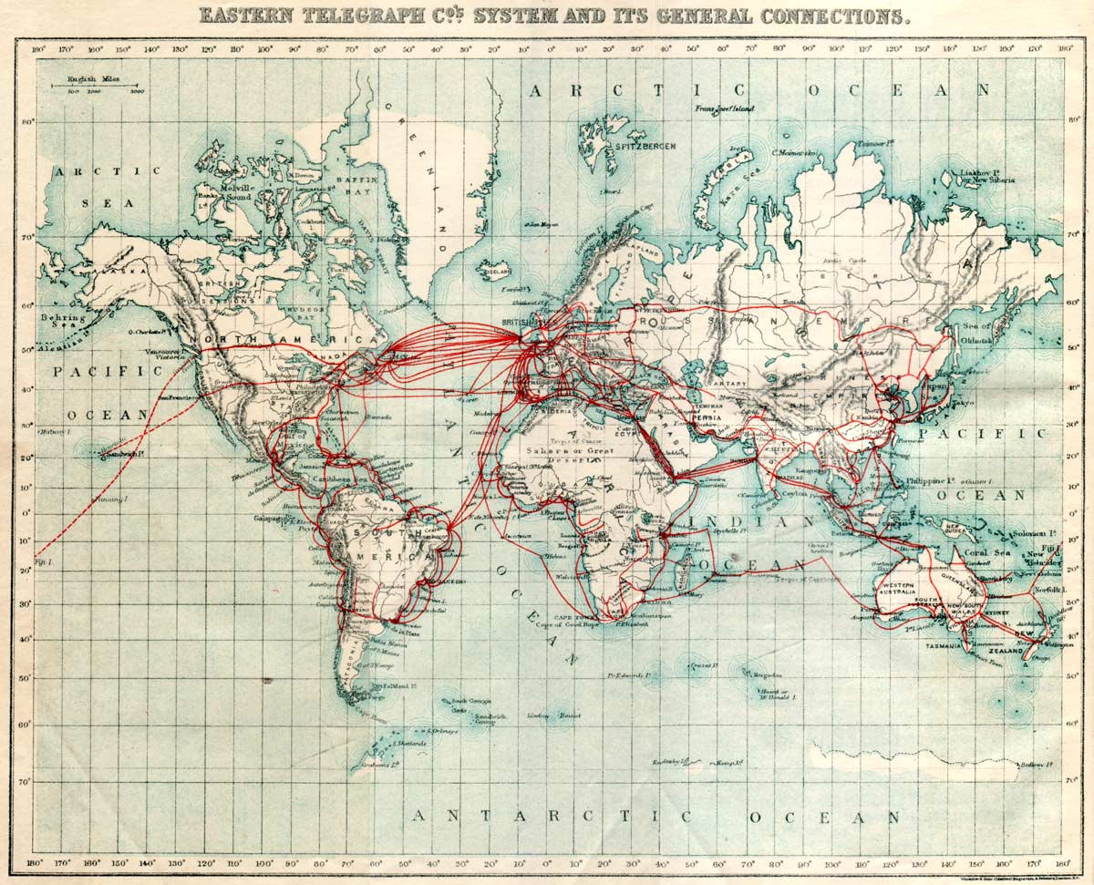

Slide 10
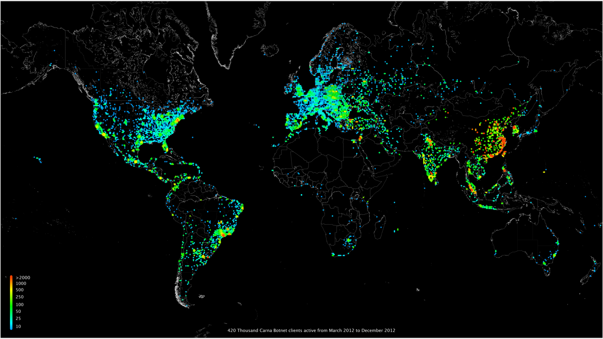
Notes:
http://internetcensus2012.bitbucket.org/images/geovideo.gif
http://internetcensus2012.bitbucket.org/paper.html

Slide 11
Q: Who invented the world wide web?
Notes:
Sir Tim Berners-Lee

Slide 12
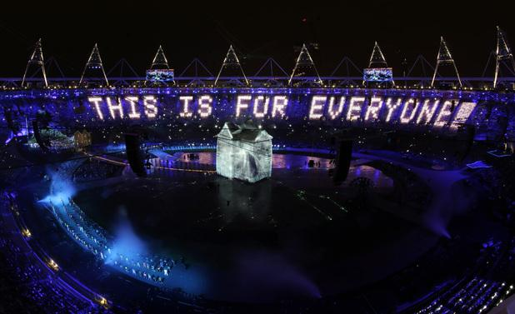
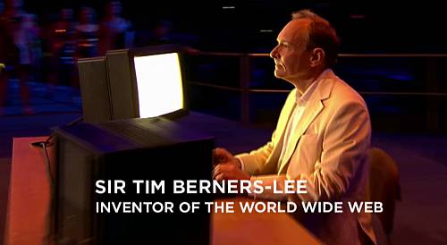
Sir Tim Berners-Lee
Tweeted “This is for everyone.”
at the London Summer Olympics
Notes:
Sir Tim Berners-Lee
He tweeted “This is for everyone” at the London Summer Olympics in 2012

Slide 13
Let’s look at changes in computing...

Slide 14
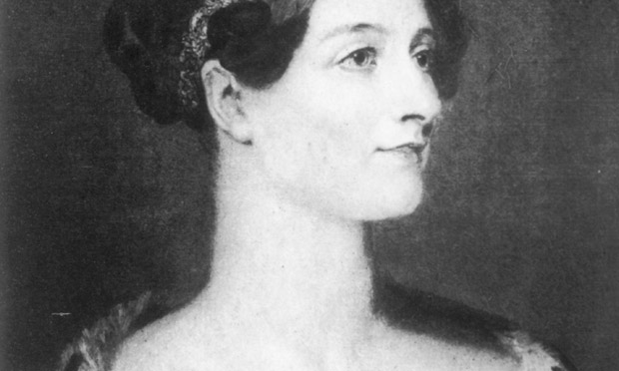
Ada Lovelace

Slide 15
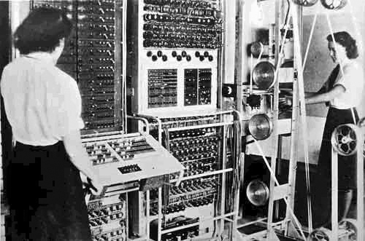
‘Colossus’ electronic computer in 1946.

Slide 16
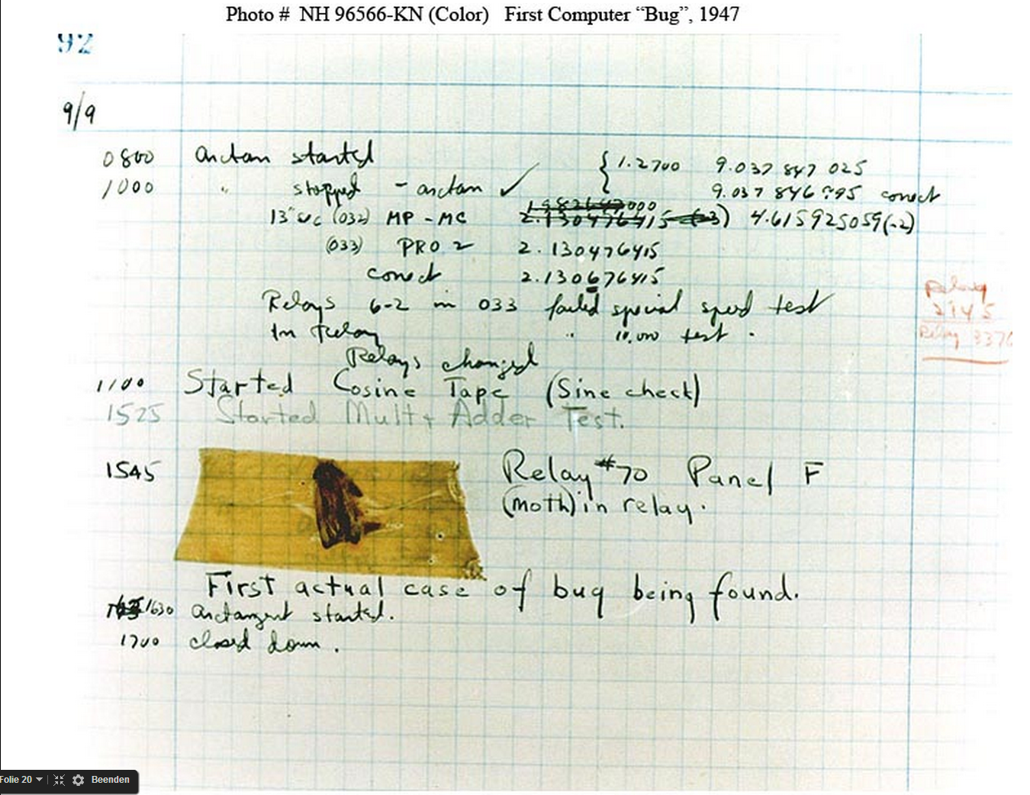
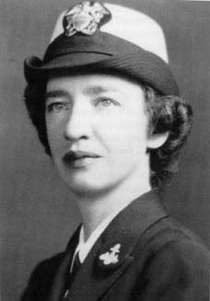
Admiral Grace Hopper
Notes:
http://www.biography.com/people/grace-hopper-21406809

Slide 17
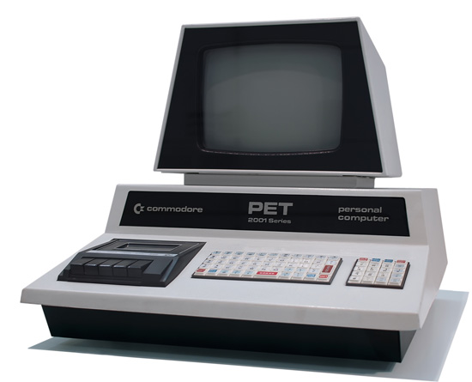
1970s

Slide 18
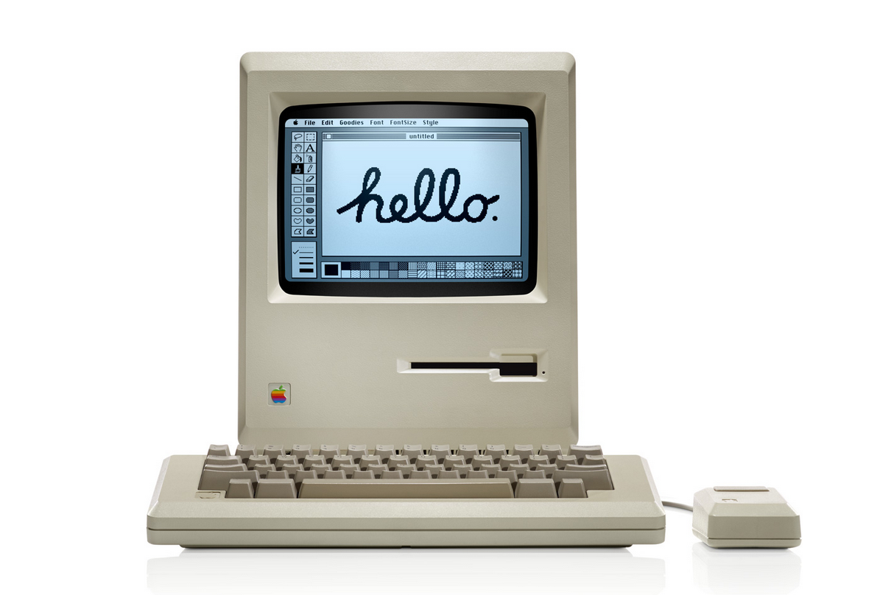
1984

Slide 19
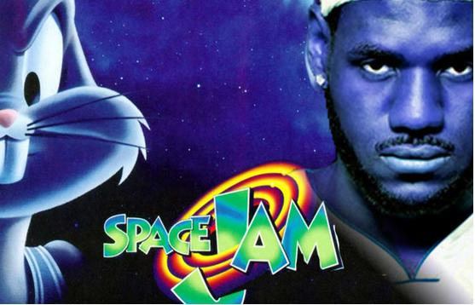
Websites used to look like this
1990s
http://www.warnerbros.com/archive/spacejam/movie/jam.htm

Slide 20
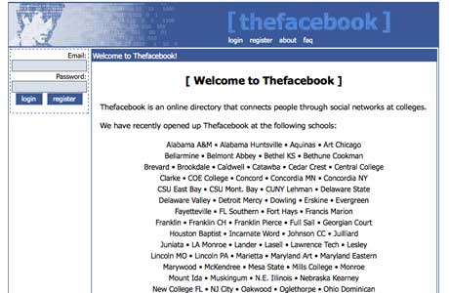
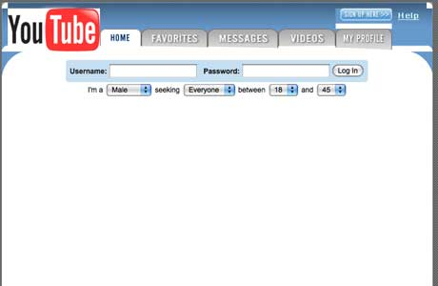
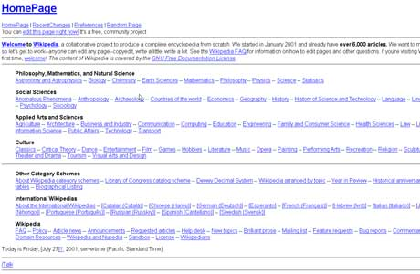
Websites used to look like this
2000s
Youtube
Facebook
Wikipedia

Slide 21
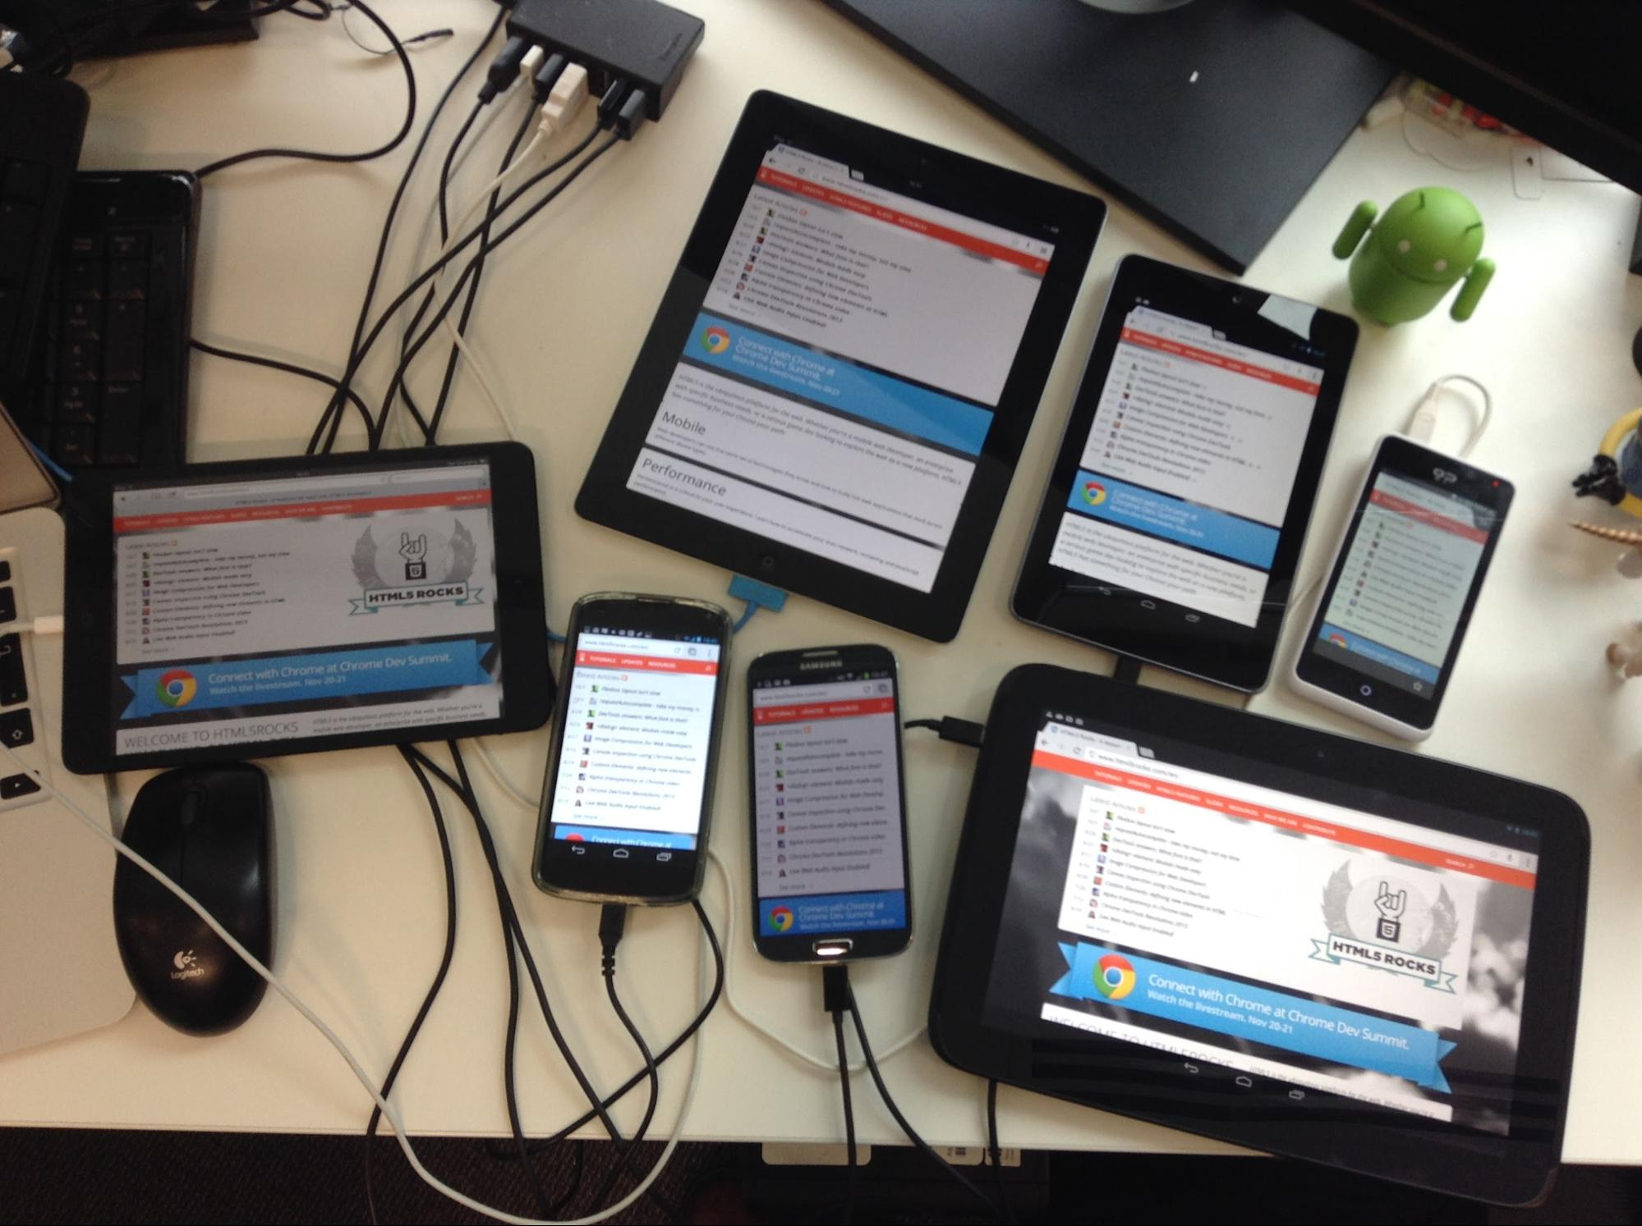
2010s
1970s
Responsive Web Design (RWD)

Slide 22
Q: What is the most popular
website in the world?
Notes:
Google with 1.17 billion unique monthly visitors.

Slide 23

with 1.17 billion
unique monthly visitors
Runners-up:
YouTube
Facebook
Baidu
Notes:
Google with 1.17 billion unique monthly visitors.

Slide 24
Alright, now for the important stuff.
What happens behind the scenes
when we look stuff up online?

Slide 25
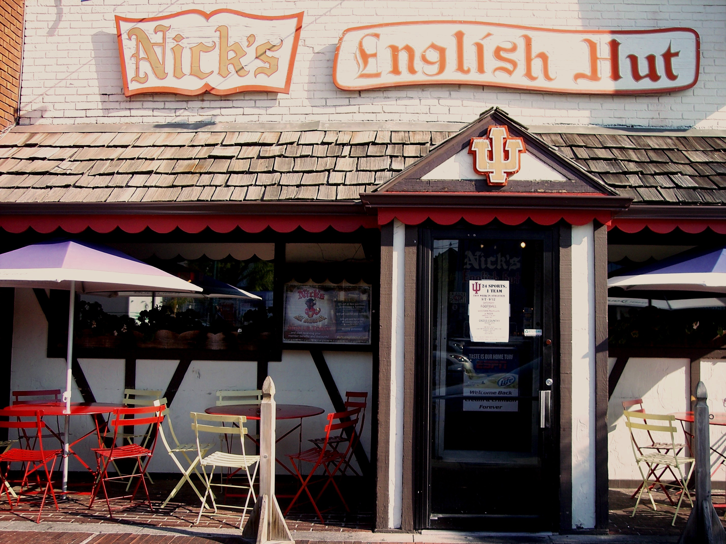
The web is a bar.
The web is a bar.

Slide 26
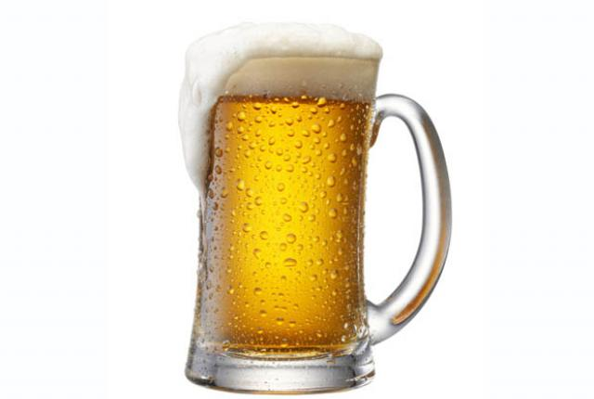
A website is a beer.
You order a beer.

Slide 27
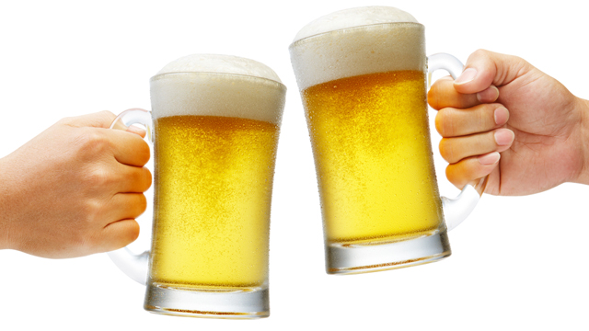
The server brings your beer.
You enjoy the contents.

Slide 28
Well, maybe it’s a little more complex than that...

Slide 29
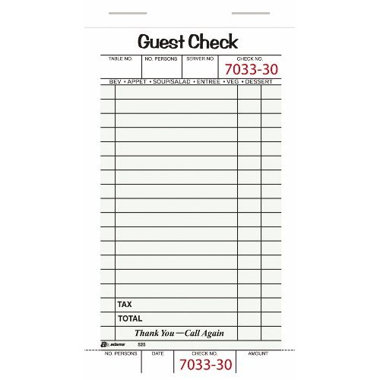
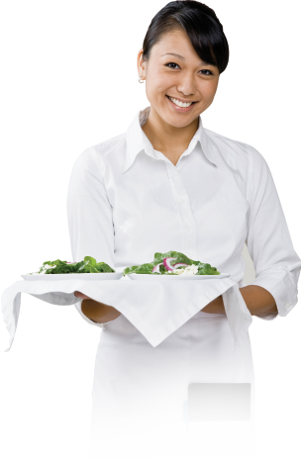
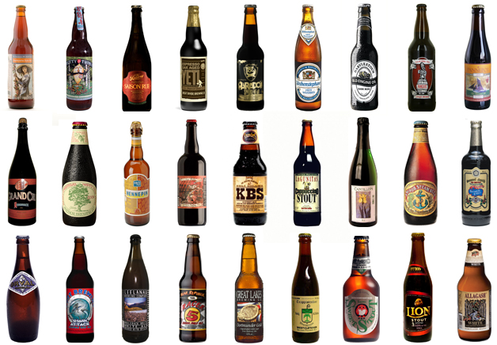
The ordering pad is like Hypertext Transfer Protocol (HTTP) - an agreement between the internet and your browser.
Your order is like a Web Page.
The Browser and the Web Server act as your server and the kitchen.
Domain Name Server (DNS) is like the menu.

Slide 30
THE WEB PAGE YOU’VE REQUESTED
The ordering pad is like Hypertext Transfer Protocol (HTTP) - an agreement between the internet and your browser.
Your order is like a Web Page.
The Browser and the Web Server act as your server and the kitchen.
Domain Name Server (DNS) is like the menu.

Slide 31
THE WEB PAGE YOU’VE REQUESTED
The ordering pad is like Hypertext Transfer Protocol (HTTP) - an agreement between the internet and your browser.
Your order is like a Web Page.
YOUR BROWSER AND THE WEB SERVER
The Browser and the Web Server act as your server and the kitchen.
Domain Name Server (DNS) is like the menu.

Slide 32
THE WEB PAGE YOU’VE REQUESTED
The ordering pad is like Hypertext Transfer Protocol (HTTP) - an agreement between the internet and your browser.
Your order is like a Web Page.
THE URL OF THE WEBSITE YOU REQUESTED
YOUR BROWSER AND THE WEB SERVER
The Browser and the Web Server act as your server and the kitchen.
Domain Name Server (DNS) is like the menu.

Slide 33
THE RULES
THE WEB PAGE YOU’VE REQUESTED
The ordering pad is like Hypertext Transfer Protocol (HTTP) - an agreement between the internet and your browser.
Your order is like a Web Page.
THE URL OF THE WEBSITE YOU REQUESTED
YOUR BROWSER AND THE WEB SERVER
The Browser and the Web Server act as your server and the kitchen.
Domain Name Server (DNS) is like the menu.

Slide 34
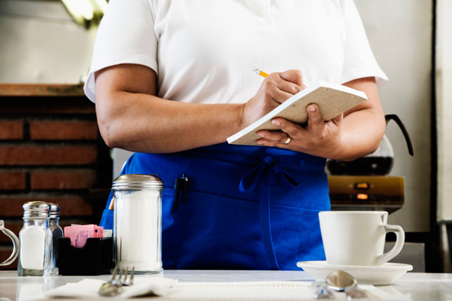
HTTP (“the rules”)
The protocol (rules, manners) used to pass HTML around. It's the rules used by computers to pass each other information. It makes it so a Windows machine can talk to a Mac can talk to a Linux box.
HTTP = HyperText Transfer Protocol = http://www...
This is like your server writing down “#42 with cheese.” It’s somewhat cryptic for you, but the kitchen knows what that means.

Slide 35
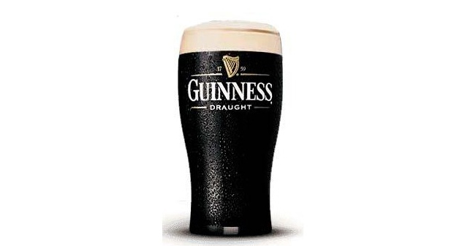
DNS (“the brand name”)
DNS = Domain Name Server
This translates the IP address into an easy-recognizable URL for human use.
You don’t just want a webpage, you want a specific webpage. You don’t just want to order a beer from the menu, you want to order a specific beer and you call it by name.

Slide 36

URL = web addresses for humans
URI / URL = Uniform Resource Identifier / Locator
http://www.apple.com

Slide 37
IP Address
But computers really like numbers and are able to process them much more quickly than they can letters and human language.
17.151.0.151 = apple.com
The Domain Name Server, then, is like a big address book. It keeps track of what numbers (physical address) go with what names (URL).
http://17.149.160.10

Slide 38
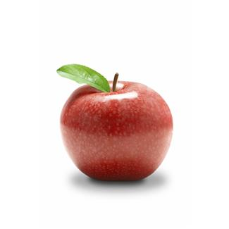
Wait, what is Apple's IP address?
?

Slide 39
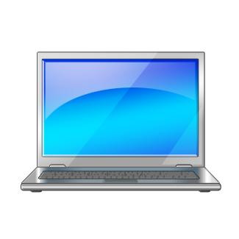
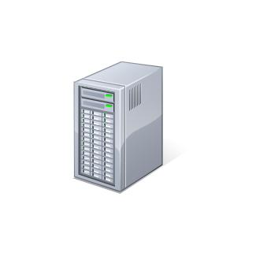
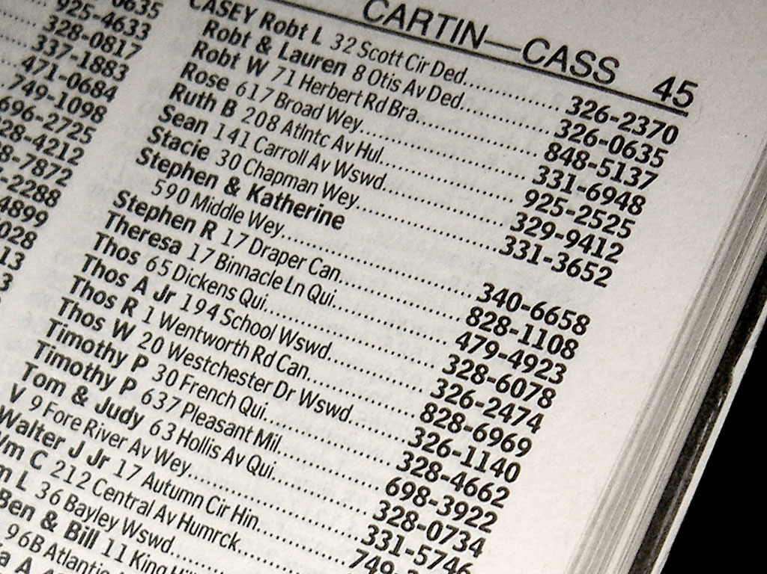
The Request / Response Cycle
Your computer in Indiana
STEP 3
STEP 2
Apple's Web Server
looks through folders in its website and finds the content requested, and returns it as HTML (if it is not already).
Your computer finds Apple's website using the IP address and puts in a request for the home page.
STEP 1
Your computer asks for the IP address for www.apple.com.

Slide 40
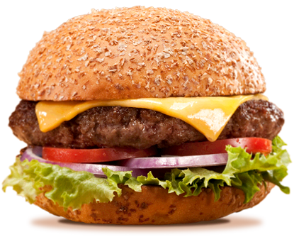
Humor me, but now let’s think of a website as a hamburger.

Slide 41
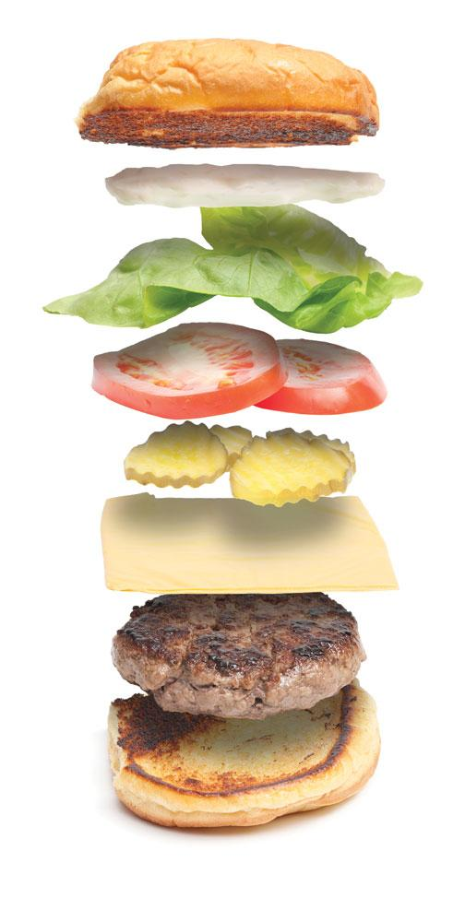
HTML is like the bun. It provides structure. It holds all the other pieces together.
HTML contains and structures (but DOES NOT position) content. The content is the meat. Obviously.

Slide 42
CSS (Cascading Style Sheets) is what makes a web page pretty, special and stylish.
CSS also sets the positioning of elements in a web page.

Slide 43
Javascript allows elements to be manipulated even once they've been served.
It's like you taking the tomato and moving it above the lettuce and then rotating the pickles.
Slideshows, button rollovers and other interactive features are often done with JS.

Slide 44

Different browsers are kind of like different chefs.
Given the same exact ingredients, the burger will still look and taste a little different depending on who prepares all the parts.

Slide 45
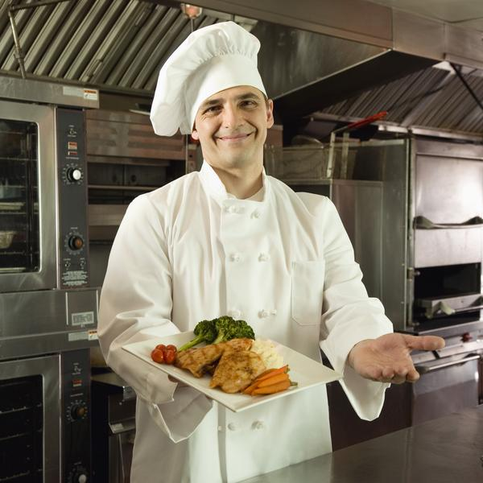
Safari

Slide 46
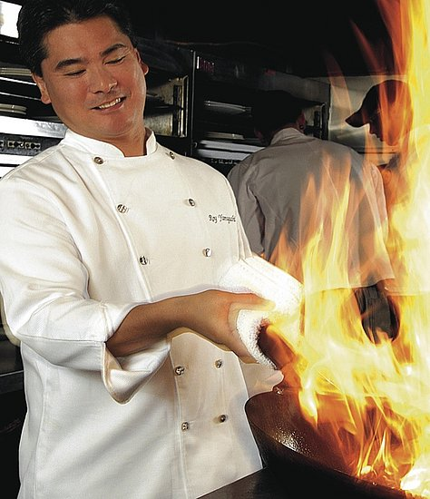
Firefox

Slide 47
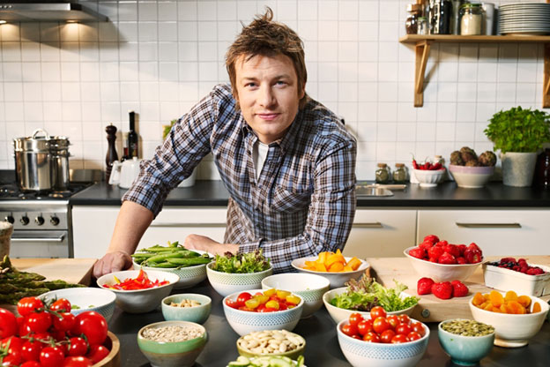
Chrome
Notes:
Alternate options:
IE - drunk guy in the back making fried onion rings
Firefox - trained in cooking school, fancy meals
Chrome - celebrity chef - corporate sponsored, bells and whistles, still a little quirky
Safari - chef at the local diner or greasy spoon

Slide 48
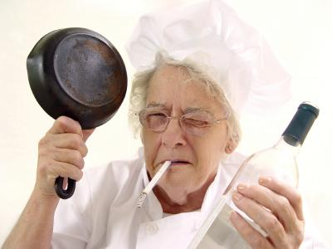
Internet Explorer

Slide 49
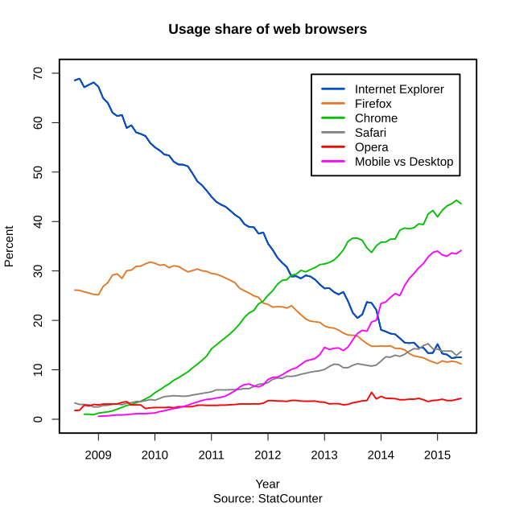

Slide 50
This is why we need web standards, people.

